Slide 1
Department of Applied Mathematics and Computational Sciences
III Sem M.Sc.Software Systems
Transform Techniques
Dr. V. Suresh kumar

Slide 2
Z Transform

Slide 3
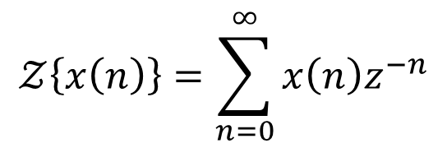
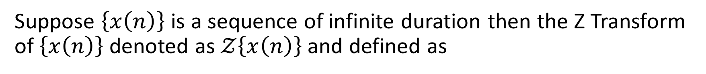

Definition
Suppose $\left\{x\left(n\right)\right\}$ is a sequence of infinite duration then the Z Transform of $\left\{x\left(n\right)\right\}$ denoted as $𝒵\left\{x\left(n\right)\right\}$ and defined as
$$𝒵\left\{x\left(n\right)\right\}=\sum_{n=0}^{∞}{x\left(n\right)z^{−n}}$$
$$𝒵\left\{x\left(n\right)\right\}=X(z)$$

Slide 4
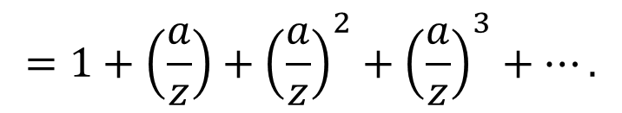
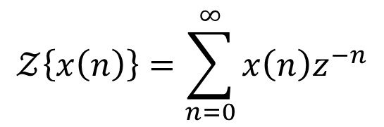
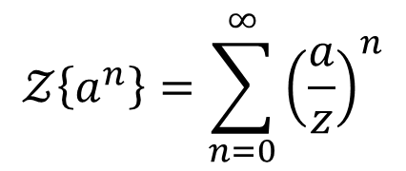

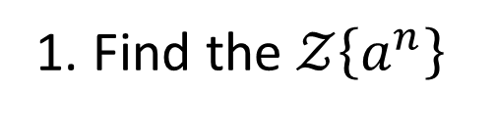
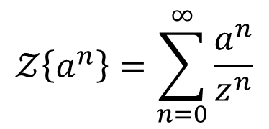

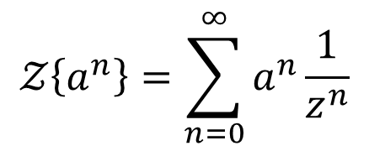

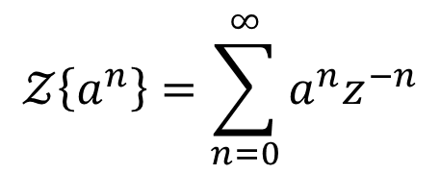

Transform of standard functions
1. Find the $𝒵\left\{a^{n}\right\}$
Ans:
$$𝒵\left\{a^{n}\right\}=\sum_{n=0}^{∞}{\frac{a^{n}}{z^{n}}}$$
$$𝒵\left\{x\left(n\right)\right\}=\sum_{n=0}^{∞}{x\left(n\right)z^{−n}}$$
$$𝒵\left\{a^{n}\right\}=\sum_{n=0}^{∞}{{\left(\frac{a}{z}\right)}^{n}}$$
$$𝒵\left\{a^{n}\right\}=\sum_{n=0}^{∞}{a^{n}z^{−n}}$$
$$=1+\left(\frac{a}{z}\right)+{\left(\frac{a}{z}\right)}^{2}+{\left(\frac{a}{z}\right)}^{3}+….$$
$$𝒵\left\{a^{n}\right\}=\sum_{n=0}^{∞}{a^{n}\frac{1}{z^{n}}}$$
$$=1+x+x^{2}+x^{3}+x^{4}+…$$
$$x=\frac{a}{z}$$
$$={\left(1−x\right)}^{−1}$$
$$\left|x\right|<1$$

Slide 5



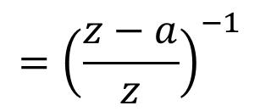

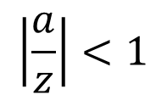

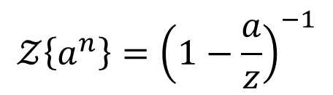
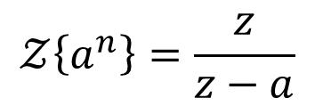

Contd…
$$𝒵\left\{a^{n}\right\}={\left(1−\frac{a}{z}\right)}^{−1}$$
$$\left|\frac{a}{z}\right|<1$$
$$={\left(\frac{z−a}{z}\right)}^{−1}$$
$$y$$
$$|a|<|z|$$
$$|a|$$
$$𝒵\left\{a^{n}\right\}=\frac{z}{z−a}$$
$$\left|z\right|>|a|$$
$$|a|$$
$$x$$
ROC

Slide 6

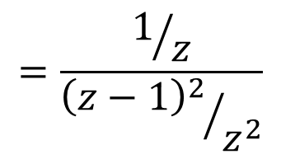


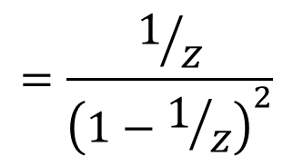
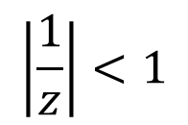
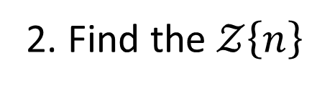


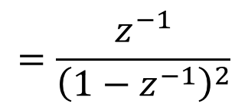

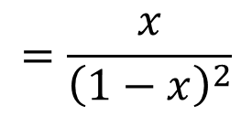
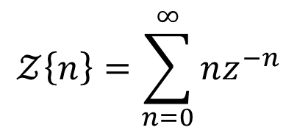

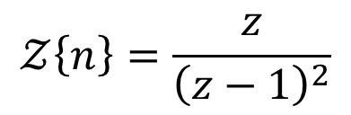
Transformation contd…
$$=\frac{x}{{\left(1−x\right)}^{2}}$$
2. Find the $𝒵\left\{n\right\}$
Ans:
$$=\frac{z^{−1}}{{\left(1−z^{−1}\right)}^{2}}$$
$$𝒵\left\{x\left(n\right)\right\}=\sum_{n=0}^{∞}{x\left(n\right)z^{−n}}$$
$$\left|z^{−1}\right|<1$$
$$=\frac{1/z}{{\left(1−1/z\right)}^{2}}$$
$$𝒵\left\{n\right\}=\sum_{n=0}^{∞}{nz^{−n}}$$
$$\left|\frac{1}{z}\right|<1$$
$$=\frac{1/z}{{{\left(z−1\right)}^{2}}/{z^{2}}}$$
$$=0+z^{−1}+2z^{−2}+3z^{−3}+4z^{−4}+…$$
$$𝒵\left\{n\right\}=\frac{z}{{\left(z−1\right)}^{2}}$$
$$\left|z\right|>1$$
$$=x+2x^{2}+3x^{3}+4x^{4}+…$$
$$x=z^{−1}$$
$$=x(1+2x+3x^{2}+…)$$
$$=x{\left(1−x\right)}^{−2}$$
$$\left|x\right|<1$$

Slide 7
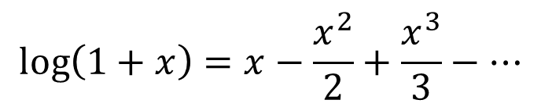
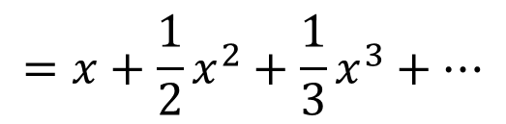



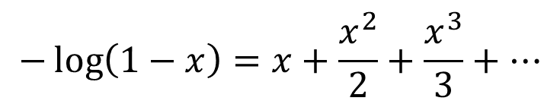
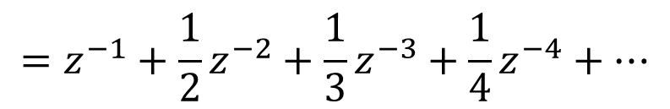

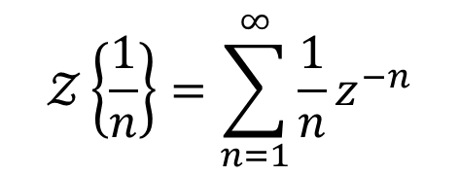
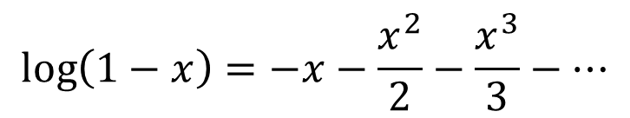
Transformation contd…
3. Find the $𝒵\left\{\frac{1}{n}\right\}$
$$\log\left(1+x\right)=x−\frac{x^{2}}{2}+\frac{x^{3}}{3}−…$$
Ans:
$$𝒵\left\{x\left(n\right)\right\}=\sum_{n=0}^{∞}{x\left(n\right)z^{−n}}$$
$$\left|x\right|<1$$
$$\log\left(1−x\right)=−x−\frac{x^{2}}{2}−\frac{x^{3}}{3}−…$$
$$𝒵\left\{\frac{1}{n}\right\}=\sum_{n=1}^{∞}{\frac{1}{n}z^{−n}}$$
$$−\log\left(1−x\right)=x+\frac{x^{2}}{2}+\frac{x^{3}}{3}+…$$
$$\left|x\right|<1$$
$$=z^{−1}+\frac{1}{2}z^{−2}+\frac{1}{3}z^{−3}+\frac{1}{4}z^{−4}+…$$
$$=x+\frac{1}{2}x^{2}+\frac{1}{3}x^{3}+…$$
$${x=z}^{−1}$$

Slide 8

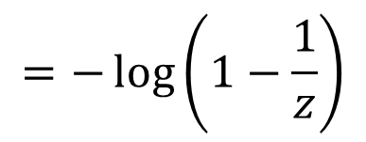
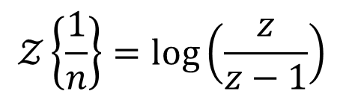
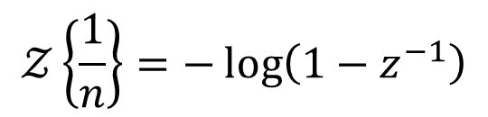
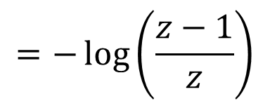
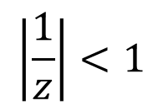

Transformation contd…
$$𝒵\left\{\frac{1}{n}\right\}=−\log\left(1−z^{−1}\right)$$
$$\left|z^{−1}\right|<1$$
$$=−\log\left(1−\frac{1}{z}\right)$$
$$\left|\frac{1}{z}\right|<1$$
$$=−\log\left(\frac{z−1}{z}\right)$$
$$𝒵\left\{\frac{1}{n}\right\}=\log\left(\frac{z}{z−1}\right)$$
$$\left|z\right|>1$$

Slide 9
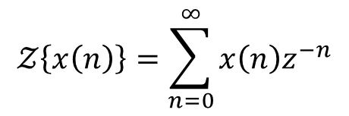
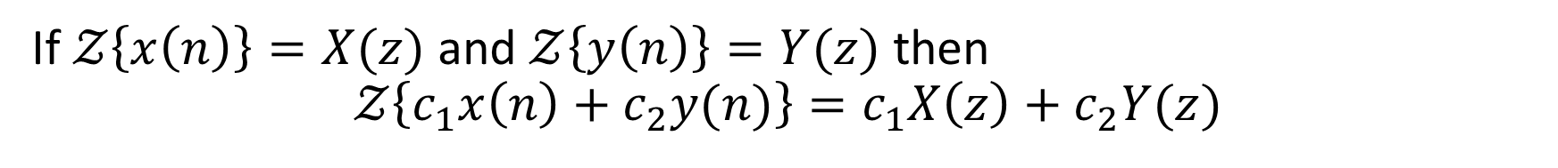

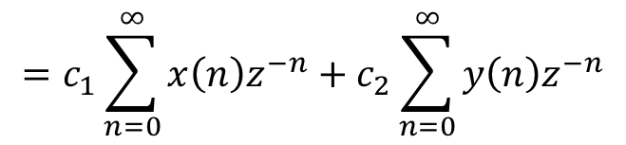
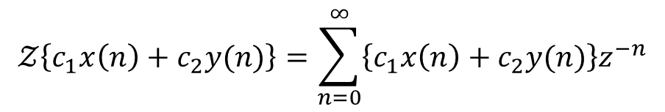
Linear property
If $𝒵\left\{x\left(n\right)\right\}=X(z)$ and $𝒵\left\{y\left(n\right)\right\}=Y(z)$ then
$$𝒵\left\{c_{1}x\left(n\right)+c_{2}y(n)\right\}=c_{1}X\left(z\right)+c_{2}Y(z)$$
Proof
$$𝒵\left\{x\left(n\right)\right\}=\sum_{n=0}^{∞}{x\left(n\right)z^{−n}}$$
$$𝒵\left\{c_{1}x\left(n\right)+c_{2}y(n)\right\}=\sum_{n=0}^{∞}{\left\{c_{1}x\left(n\right)+c_{2}y(n)\right\}z^{−n}}$$
$$=c_{1}\sum_{n=0}^{∞}{x\left(n\right)z^{−n}}+c_{2}\sum_{n=0}^{∞}{y\left(n\right)z^{−n}}$$
$$=c_{1}X\left(z\right)+c_{2}Y(z)$$

Slide 10
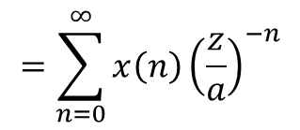
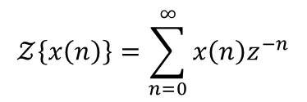

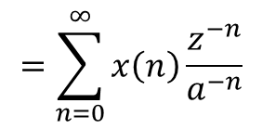
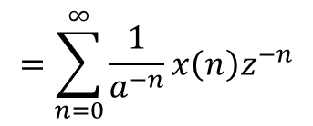

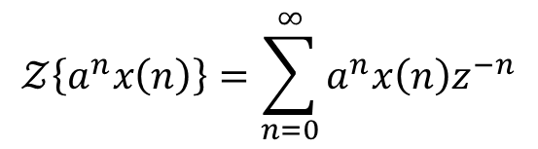

Change of scale property
If $𝒵\left\{x\left(n\right)\right\}=X(z)$ then $𝒵\left\{a^{n}x\left(n\right)\right\}=X\left(\frac{z}{a}\right)$
Proof
$$𝒵\left\{x\left(n\right)\right\}=\sum_{n=0}^{∞}{x\left(n\right)z^{−n}}$$
$$=X(z)$$
$$=\sum_{n=0}^{∞}{x\left(n\right)}{\left(\frac{z}{a}\right)}^{−n}$$
$$𝒵\left\{a^{n}x\left(n\right)\right\}=\sum_{n=0}^{∞}{a^{n}x\left(n\right)z^{−n}}$$
$$=X\left(\frac{z}{a}\right)$$
$$=\sum_{n=0}^{∞}{\frac{1}{a^{−n}}x\left(n\right)z^{−n}}$$
$𝒵\left\{a^{n}x\left(n\right)\right\}=X\left(\frac{z}{a}\right)$
$$=\sum_{n=0}^{∞}{x\left(n\right)\frac{z^{−n}}{a^{−n}}}$$

Slide 11
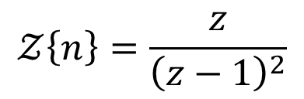
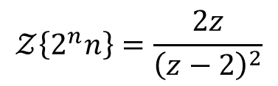
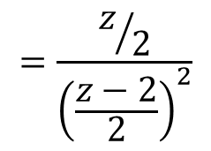
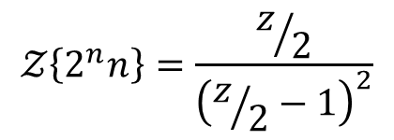

Example problems
1. Find the $𝒵\left\{2^{n}n\right\}$
Ans:
$$𝒵\left\{n\right\}=\frac{z}{{\left(z−1\right)}^{2}}$$
$$𝒵\left\{a^{n}x\left(n\right)\right\}=X\left(\frac{z}{a}\right)$$
We have
and
$$𝒵\left\{2^{n}n\right\}=\frac{z/2}{{\left(z/2−1\right)}^{2}}$$
$$=\frac{z/2}{{\left(\frac{z−2}{2}\right)}^{2}}$$
$$𝒵\left\{2^{n}n\right\}=\frac{2z}{{\left(z−2\right)}^{2}}$$

Slide 12
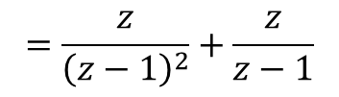
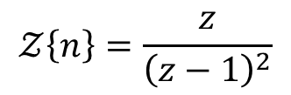


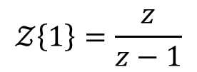
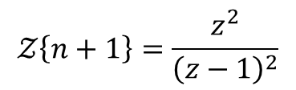
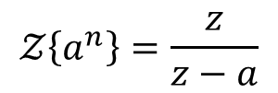

Problems contd…
2. Find the $𝒵\left\{n+1\right\}$
$$=\frac{z}{{\left(z−1\right)}^{2}}+\frac{z}{z−1}$$
Ans:
$$𝒵\left\{n\right\}=\frac{z}{{\left(z−1\right)}^{2}}$$
We have
$$=\frac{z+z(z−1)}{{\left(z−1\right)}^{2}}$$
and
$$𝒵\left\{a^{n}\right\}=\frac{z}{z−a}$$
$$𝒵\left\{n+1\right\}=\frac{z^{2}}{{\left(z−1\right)}^{2}}$$
$$𝒵\left\{1\right\}=\frac{z}{z−1}$$
$$𝒵\left\{c_{1}x\left(n\right)+c_{2}y(n)\right\}=c_{1}X\left(z\right)+c_{2}Y(z)$$
$𝒵\left\{n+1\right\}=𝒵\left\{n\right\}$+$𝒵\left\{1\right\}$

Slide 13




Problems contd…
3. Find the $𝒵\left\{n−1\right\}$
$$=\frac{z}{{\left(z−1\right)}^{2}}−\frac{z}{z−1}$$
Ans:
$$𝒵\left\{n\right\}=\frac{z}{{\left(z−1\right)}^{2}}$$
We have
$$=\frac{z−z(z−1)}{{\left(z−1\right)}^{2}}$$
and
$$𝒵\left\{a^{n}\right\}=\frac{z}{z−a}$$
$$𝒵\left\{n−1\right\}=\frac{2z−z^{2}}{{\left(z−1\right)}^{2}}$$
$$𝒵\left\{1\right\}=\frac{z}{z−1}$$
$$𝒵\left\{c_{1}x\left(n\right)+c_{2}y(n)\right\}=c_{1}X\left(z\right)+c_{2}Y(z)$$
$$𝒵\left\{n−1\right\}=𝒵\left\{n\right\}−𝒵\left\{1\right\}$$

Slide 14








Shifting property
$$𝒵\left\{x\left(n−k\right)\right\}=z^{−k}𝒵\left\{x\left(n\right)\right\}$$
Proof
$$𝒵\left\{x\left(n\right)\right\}=\sum_{n=0}^{∞}{x\left(n\right)z^{−n}}$$
$$𝒵\left\{x\left(n−k\right)\right\}=z^{−k}\sum_{m=0}^{∞}{x\left(m\right)z^{−m}}$$
$$𝒵\left\{x\left(n−k\right)\right\}=\sum_{n=0}^{∞}{x\left(n−k\right)z^{−n}}$$
$$𝒵\left\{x\left(n−k\right)\right\}=z^{−k}𝒵\left\{x\left(n\right)\right\}$$
put
$$m=n−k$$
$$=\sum_{m=−k}^{∞}{x\left(m\right)z^{−(m+k)}}$$
$$=\sum_{m=0}^{∞}{x\left(m\right)z^{−m}z^{−k}}$$

Slide 15







Shifting property
$$𝒵\left\{x\left(n+1\right)\right\}=z𝒵\left\{x\left(n\right)\right\}−zx(0)$$
Proof
$$𝒵\left\{x\left(n\right)\right\}=\sum_{n=0}^{∞}{x\left(n\right)z^{−n}}$$
$$𝒵\left\{x\left(n+1\right)\right\}=z^{1}\sum_{m=0}^{∞}{x\left(m\right)z^{−m}}−zx(0)$$
$$𝒵\left\{x\left(n+1\right)\right\}=\sum_{n=0}^{∞}{x\left(n+1\right)z^{−n}}$$
$$𝒵\left\{x\left(n+1\right)\right\}=z𝒵\left\{x\left(n\right)\right\}−zx(0)$$
put
$$m=n+1$$
$$=\sum_{m=1}^{∞}{x\left(m\right)z^{−(m−1)}}$$
$$=\sum_{m=0}^{∞}{x\left(m\right)z^{−m}z^{1}}−zx(0)$$

Slide 16
Property contd…
Similarly
$$𝒵\left\{x\left(n+2\right)\right\}=z^{2}𝒵\left\{x\left(n\right)\right\}−z^{2}x\left(0\right)−zx(1)$$
$$𝒵\left\{x\left(n+3\right)\right\}=z^{3}𝒵\left\{x\left(n\right)\right\}−z^{3}x\left(0\right)−z^{2}x\left(1\right)−zx(2)$$
So on…

Slide 17







Derivative of Transform
If $𝒵\left\{x\left(n\right)\right\}=X(z)$ then $𝒵\left\{n x\left(n\right)\right\}=−z \frac{d}{dz}X(z)$.
Proof
$$𝒵\left\{x\left(n\right)\right\}=\sum_{n=0}^{∞}{x\left(n\right)z^{−n}}$$
$$\frac{1}{z}\sum_{n=0}^{∞}{n x\left(n\right)z^{−n}}=−\frac{d}{dz}X(z)$$
$=X(z)$
Differentiate both sides w.r.t. z
$$\sum_{n=0}^{∞}{n x\left(n\right)z^{−n}}=−z\frac{d}{dz}X(z)$$
$$\frac{d}{dz}\sum_{n=0}^{∞}{x\left(n\right)z^{−n}}=\frac{d}{dz}X(z)$$
$$𝒵\left\{n x\left(n\right)\right\}=−z \frac{d}{dz}X(z)$$
$$\sum_{n=0}^{∞}{(−n)x\left(n\right)z^{−n−1}}=\frac{d}{dz}X(z)$$
$$−z^{−1}\sum_{n=0}^{∞}{n x\left(n\right)z^{−n}}=\frac{d}{dz}X(z)$$

Slide 18






Example
1. Find the $𝒵\left\{\frac{1}{n−1}\right\}$
Ans:
Take $x\left(n\right)=\frac{1}{n}$
$$𝒵\left\{\frac{1}{n}\right\}=\log\left(\frac{z}{z−1}\right)$$
$$x\left(n−1\right)=\frac{1}{n−1}$$
$$𝒵\left\{\frac{1}{n−1}\right\}=z^{−1}\log\left(\frac{z}{z−1}\right)$$
$$𝒵\left\{x\left(n−k\right)\right\}=z^{−k}𝒵\left\{x\left(n\right)\right\}$$
$$𝒵\left\{x\left(n−1\right)\right\}=z^{−1}𝒵\left\{x\left(n\right)\right\}$$

Slide 19







Examples contd...
2. Find the $𝒵\left\{\frac{1}{n+1}\right\}$
Ans:
Take $x\left(n\right)=\frac{1}{n}$
$$x\left(n+1\right)=\frac{1}{n+1}$$
$$𝒵\left\{\frac{1}{n+1}\right\}=z\log\left(\frac{z}{z−1}\right)$$
$$𝒵\left\{x\left(n+1\right)\right\}=z𝒵\left\{x\left(n\right)\right\}−zx(0)$$
$$x\left(0\right)=0$$
$$𝒵\left\{\frac{1}{n}\right\}=\log\left(\frac{z}{z−1}\right)$$

Slide 20









Examples contd…
3. Find the $𝒵\left\{n^{2}\right\}$
$$=−z \left[\frac{(z−1) −2z}{{\left(z−1\right)}^{3}}\right]$$
Ans:
Take $x\left(n\right)=n$
$$=−z \left[\frac{−1−z}{{\left(z−1\right)}^{3}}\right]$$
$$𝒵\left\{n\right\}=\frac{z}{{\left(z−1\right)}^{2}}$$
We have
$$𝒵\left\{n x\left(n\right)\right\}=−z \frac{d}{dz}X(z)$$
$$𝒵\left\{n^{2}\right\}=\frac{z(z+1)}{{\left(z−1\right)}^{3}}$$
$$𝒵\left\{n . n\right\}=−z \frac{d}{dz}\left[\frac{z}{{\left(z−1\right)}^{2}}\right]$$
$$𝒵\left\{n^{2}\right\}=−z \left[\frac{{\left(z−1\right)}^{2}\left(1\right)−z(2\left(z−1\right))}{{\left(z−1\right)}^{4}}\right]$$

Slide 21







Examples contd…
4. Find the $𝒵\left\{n(n+1)\right\}$
Ans:
$$𝒵\left\{n(n+1)\right\}=𝒵\left\{n^{2}+n\right\}$$
$$=𝒵\left\{n^{2}\right\}+𝒵\left\{n\right\}$$
$$=\frac{z(z+1)}{{\left(z−1\right)}^{3}}+\frac{z}{{\left(z−1\right)}^{2}}$$
$$=\frac{z\left(z+1\right)+z(z−1)}{{\left(z−1\right)}^{3}}$$
$$𝒵\left\{n(n+1)\right\}=\frac{2z^{2}}{{\left(z−1\right)}^{3}}$$
$$=\frac{2z^{2}}{{\left(z−1\right)}^{3}}$$

Slide 22










Examples contd…
5. Find the $𝒵\left\{\frac{1}{n(n−1)}\right\}$
$$𝒵\left\{\frac{1}{n(n−1)}\right\}=𝒵\left\{\frac{−1}{n}\right\}+𝒵\left\{\frac{1}{(n−1)}\right\}$$
Ans:
$$\frac{1}{n(n−1)}=\frac{A}{n}+\frac{B}{n−1}$$
$$=−\log\left(\frac{z}{z−1}\right)+z^{−1}\log\left(\frac{z}{z−1}\right)$$
$$1=A\left(n−1\right)+Bn$$
$$A=−1$$
$$=log\left(\frac{z}{z−1}\right)\left(−1+\frac{1}{z}\right)$$
$$B=1$$
$$𝒵\left\{\frac{1}{n(n−1)}\right\}=\left(\frac{1−z}{z}\right)log\left(\frac{z}{z−1}\right)$$
$$\frac{1}{n(n−1)}=\frac{−1}{n}+\frac{1}{n−1}$$

Slide 23








Examples contd…
6. Find the $𝒵\left\{sin\left(\frac{nπ}{2}\right)\right\}$ and $𝒵\left\{cos\left(\frac{nπ}{2}\right)\right\}$
Ans:
$$𝒵\left\{a^{n}\right\}=\frac{z}{z−a}$$
Consider
$$𝒵\left\{r^{n}e^{inθ}\right\}=𝒵\left\{{(re^{iθ})}^{n}\right\}$$
$$=\frac{z}{z−re^{iθ}}$$
$$=\frac{z}{z−r(cosθ+i\sin{θ)}}$$
$$=\frac{z}{\left(z−rcosθ\right)−i\operatorname{rsin}{θ}}$$
$$=\frac{z}{\left(z−rcosθ\right)−i\operatorname{rsin}{θ}}\left[\frac{(z−rcosθ)+i\operatorname{rsin}{θ}}{(z−rcosθ)+i\operatorname{rsin}{θ}}\right]$$
$$=\frac{z\left[(z−rcosθ)+i\operatorname{rsin}{θ}\right]}{{\left(z−rcosθ\right)}^{2}−i^{2}r^{2}\sin^{2}{θ}}$$

Slide 24








Example contd…
$$𝒵\left\{r^{n}e^{inθ}\right\}=\frac{z\left[(z−rcosθ)+i\operatorname{rsin}{θ}\right]}{{\left(z−rcosθ\right)}^{2}−i^{2}r^{2}\sin^{2}{θ}}$$
$$𝒵\left\{ (\cos\left(\frac{nπ}{2}\right))\right\}=\frac{z^{2}}{z^{2}+1}$$
$$𝒵\left\{r^{n}(\cos{nθ}+i\sin{nθ)}\right\}=\frac{z(z−rcosθ)+i\operatorname{zrsin}{θ}}{{\left(z−rcosθ\right)}^{2}+r^{2}\sin^{2}{θ}}$$
$$𝒵\left\{(\sin\left(\frac{nπ}{2}\right))\right\}=\frac{z}{z^{2}+1}$$
$$𝒵\left\{r^{n}(\cos{nθ)}+i(r^{n}sin{nθ)}\right\}=\frac{z^{2}−zrcosθ+i\operatorname{zrsin}{θ}}{z^{2}−2zrcosθ+r^{2}\cos^{2}{θ}+r^{2}\sin^{2}{θ}}$$
$$𝒵\left\{r^{n}(\cos{nθ)}\right\}+i 𝒵\left\{(r^{n}sin{nθ)}\right\}=\frac{z^{2}−zrcosθ}{z^{2}−2zrcosθ+r^{2}}+i \frac{\operatorname{zrsin}{θ}}{z^{2}−2zrcosθ+r^{2}}$$
$$𝒵\left\{r^{n}(\cos{nθ)}\right\}=\frac{z^{2}−zrcosθ}{z^{2}−2zrcosθ+r^{2}}$$
$$𝒵\left\{r^{n}\cos\left(\frac{nπ}{2}\right)\right\}=\frac{z^{2}}{z^{2}+r^{2}}$$
$$𝒵\left\{(r^{n}sin{nθ)}\right\}=\frac{\operatorname{zrsin}{θ}}{z^{2}−2zrcosθ+r^{2}}$$
$$𝒵\left\{r^{n}sin\left(\frac{nπ}{2}\right)\right\}=\frac{zr}{z^{2}+r^{2}}$$

Slide 25


